Slide 1
Welcome!
Engineering Hands-on!

Slide 2
What is Engineering?

Slide 3
The Engineering Design Process

Slide 4
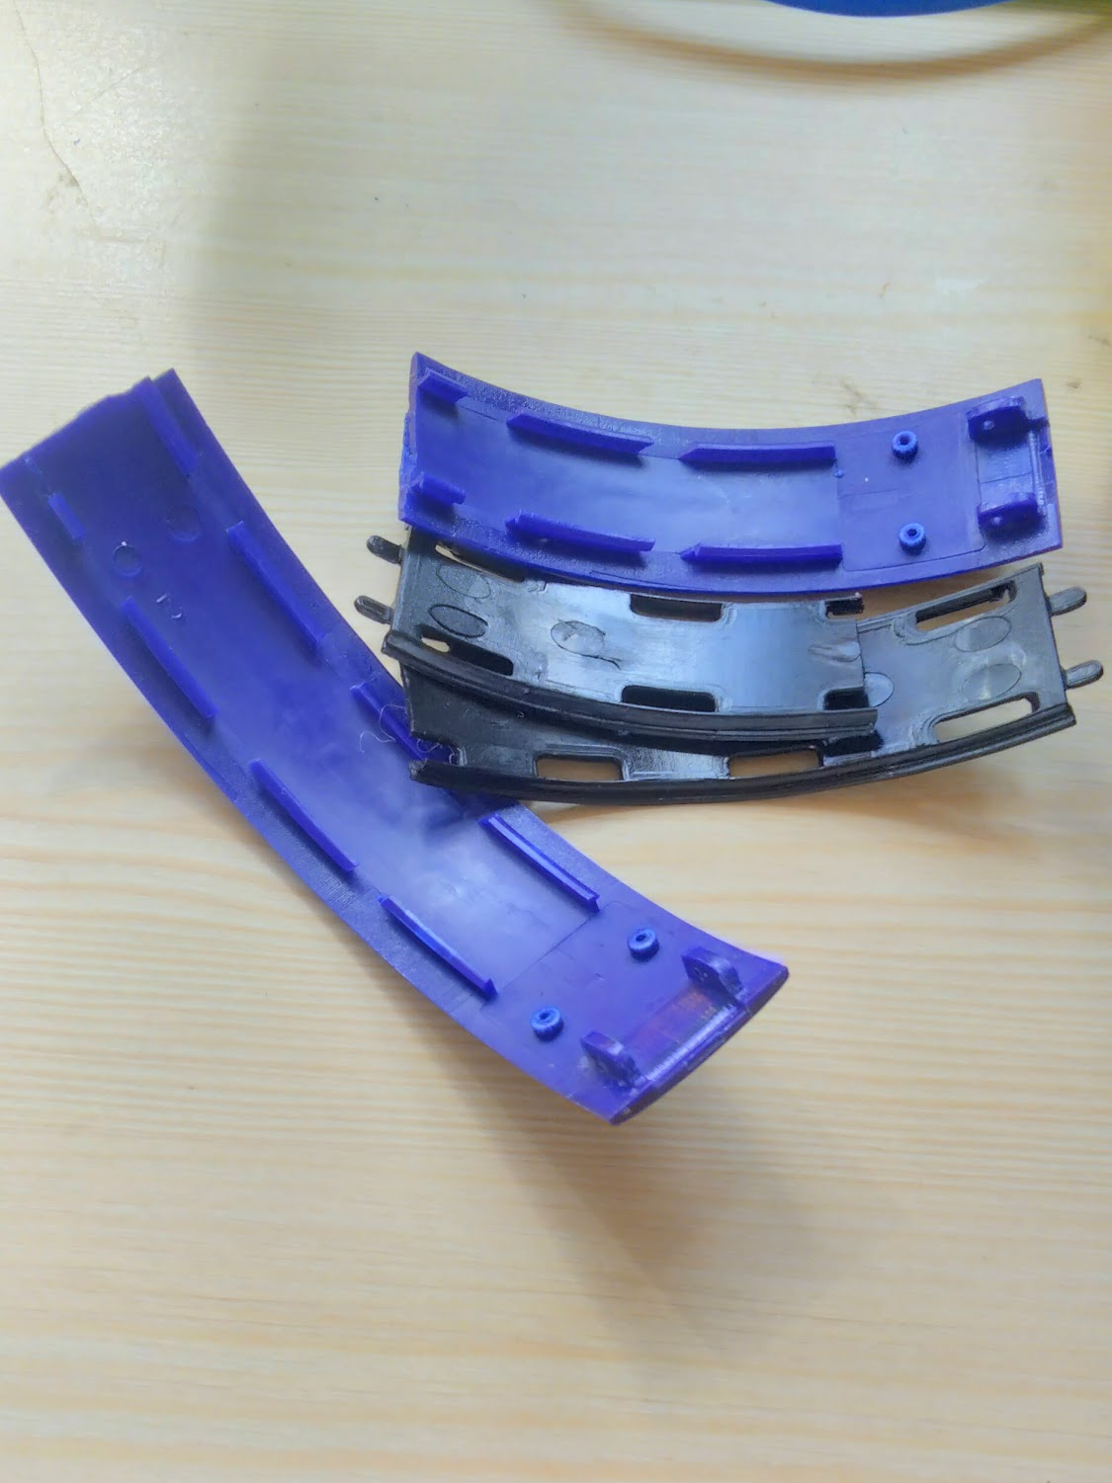
Identify the problem

Slide 5
2. Research the problem & Identify constraints/Requirements
Brand of headphones
Type of plastic
Types of glue
etc.
Budget
Durability
Time
etc.

Slide 6
3. Brainstorm possible solutions
Superglue
Tape
Make a new part
Buy a new pair
etc.

Slide 7
4. Choose the solution
Design a new part from the old one
Using CAD with Fusion360
3D Print part & replace

Slide 8
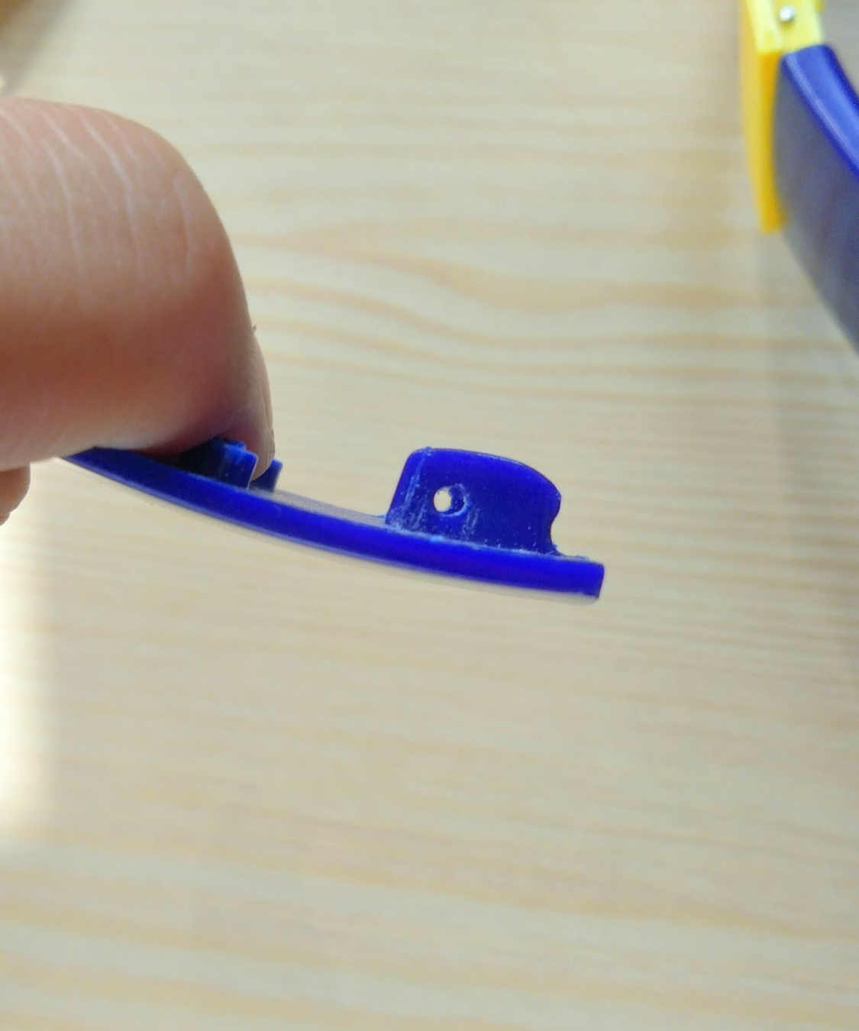
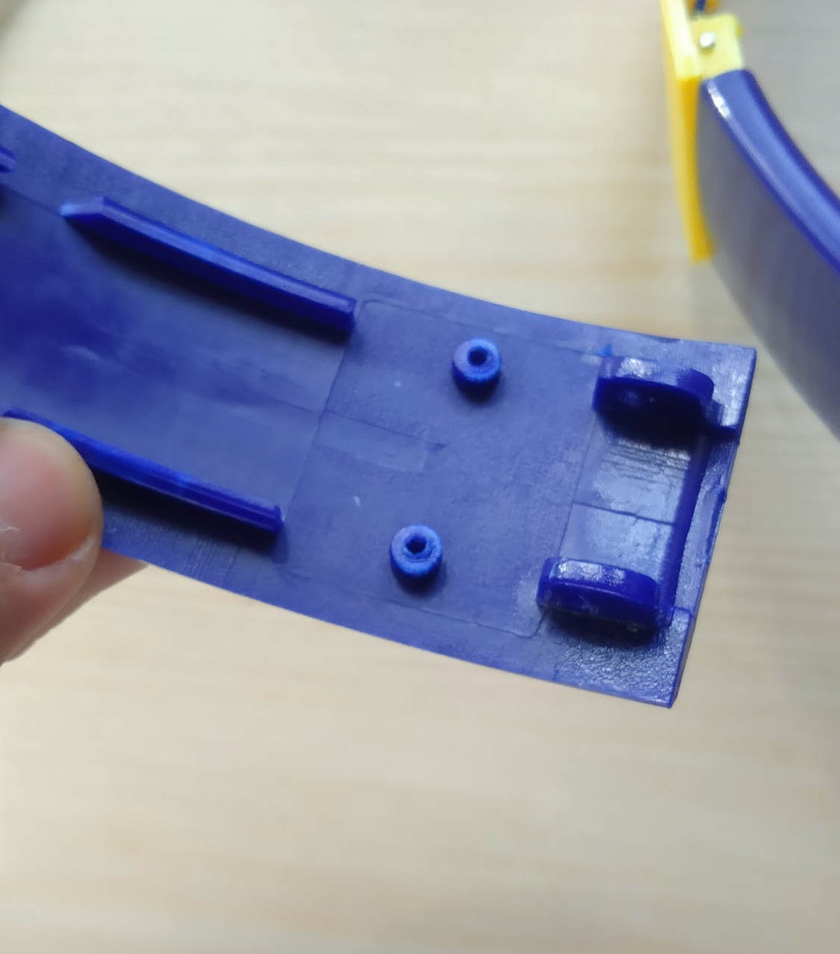
5. Design a prototype
Modelling new part from the old part
Making design choices

Slide 9
5. Design a prototype
Design demo in Fusion360

Slide 10
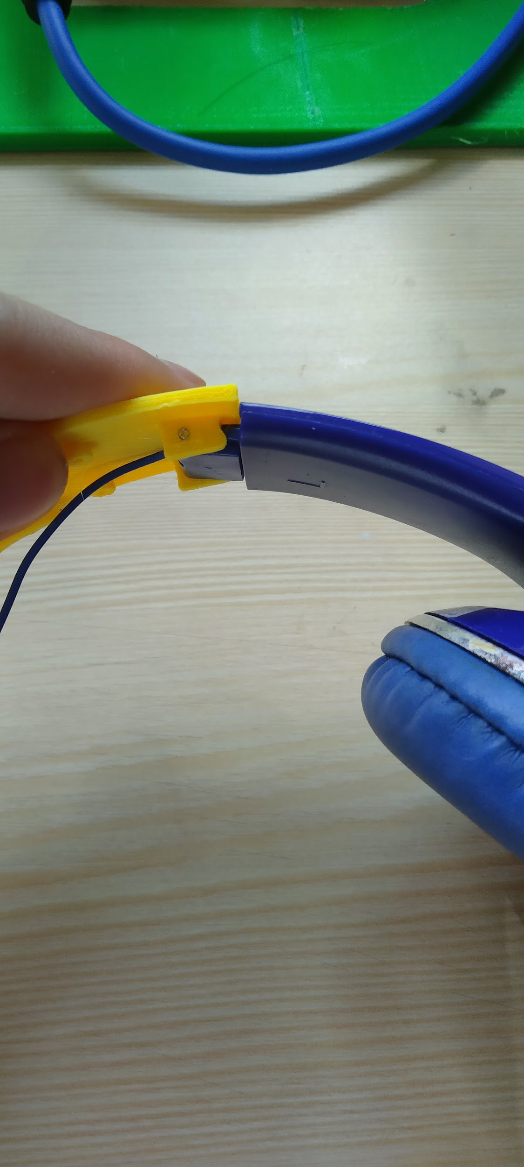
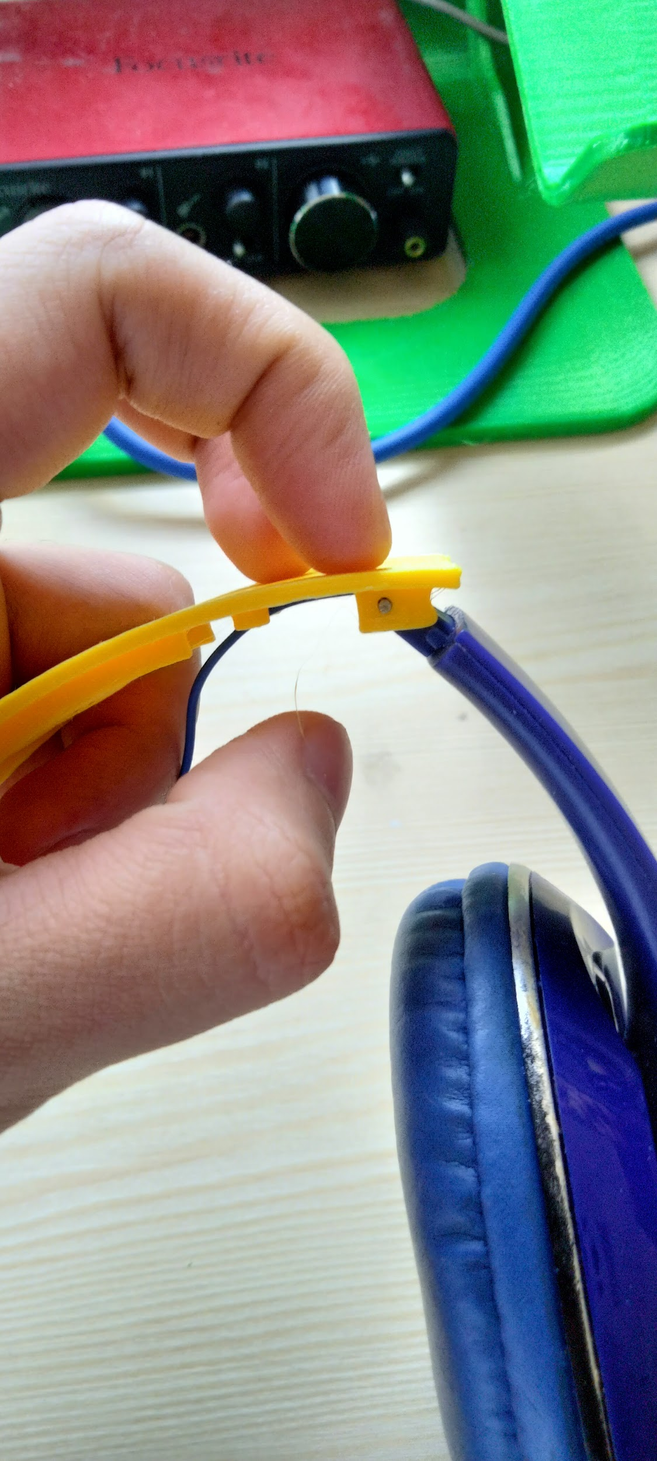
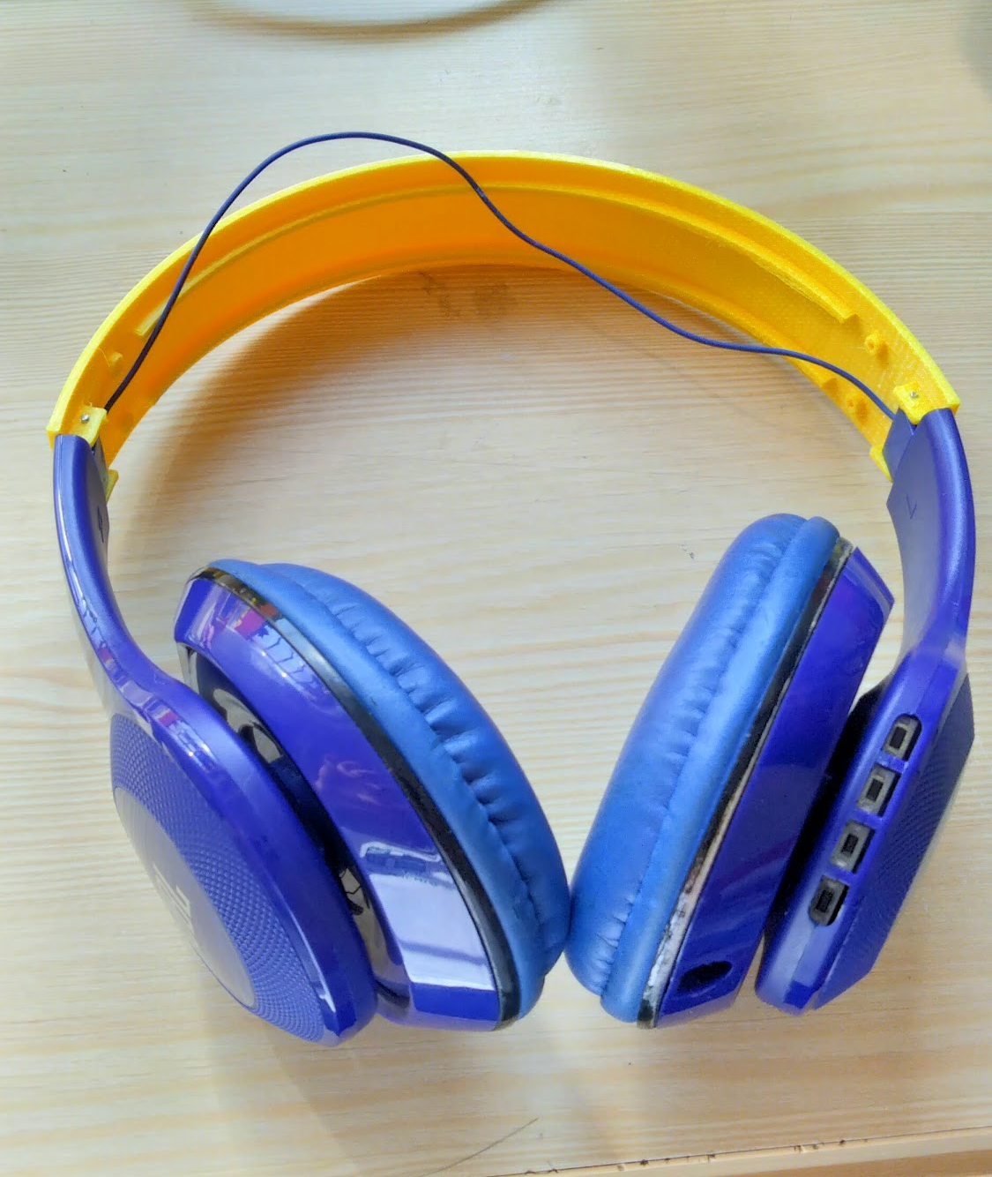
6. Test & Evaluate

Slide 11
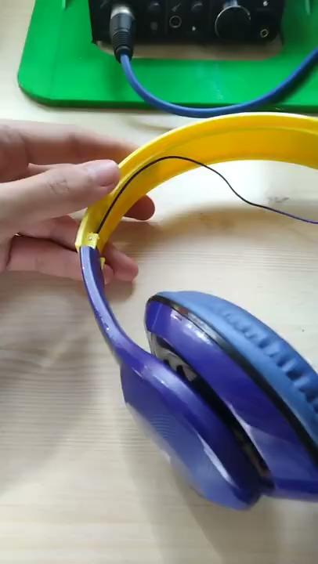
6. Test & Evaluate

Slide 12
7. Improve & Redesign if needed
Adjust location of screw holes
Print new prototype

Slide 13

Finished product:

Slide 14
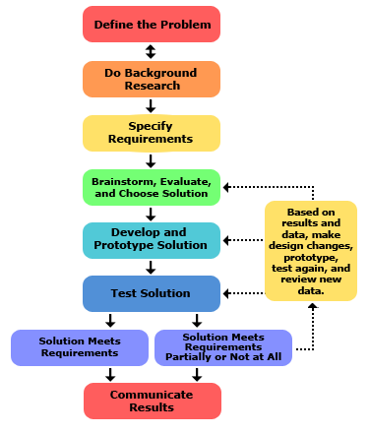

Slide 15
Safety & Guidelines
Use common sense
Get to know the space
Organization is key - put things where they’re supposed to be
Use proper protection when needed (safety glasses, gloves, etc)
Ask if you’re not sure about anything

Slide 16
Tools of Engineering
Measuring & Marking tools
Hammers
Prying tools
Wrenches, Screwdrivers
Gripping & Clamping tools
Cutting/Sawing tools
Drills & bits
Safety Equipments
Hand & Stationary power tools
Miscellaneous tools

Slide 17
Activity
Get to know how to use measuring tools
Read & record measurements

